Slide 1


Dart :
History, Design, and a
Recursive File Search Case Study
An Academic Seminar Programming Languages in Comparison
Elias Madfouni | Siegen University |February 2026

Slide 2

The Identity of Dart
Origin
Developed by Google (Lars Bak & Kasper Lund) in 2011.
Initial Goal
To replace JavaScript as the "structured" language for the web.
The Strategic Pivot
Evolved from a web-only experiment to a "client-optimized" powerhouse. Now the primary engine behind the Flutter framework.
Current Status
The engine behind Flutter, powering millions of cross-platform apps.

Slide 3
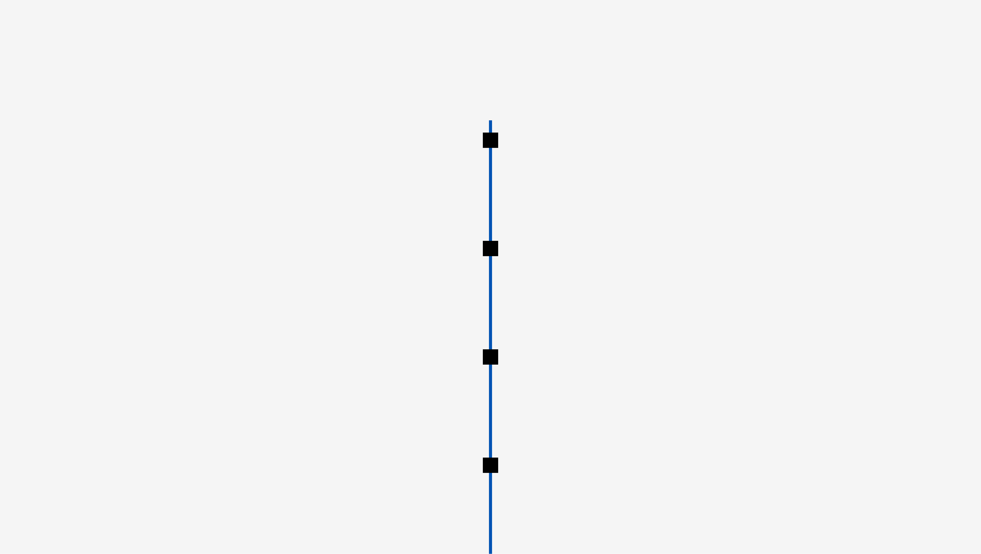
Historical Context: From "Dash" to Dart 3.0
2011
The "Dash" Era
Unveiled at GOTO Aarhus. Born from a "crisis of scale" in web development (Gmail/Maps).
2011-2017
The "Dark Ages"
Browser vendors rejected the native VM; Google pivoted to compilation (dart2js) and ECMA standardization.
2018
The Rebirth (Dart 2.0)
Shifted to a sound static type system. Aligned with the rise of Flutter for cross-platform UI.
2023
Modern Era (Dart 3.0)
Mandatory Sound Null Safety, WebAssembly (Wasm) support, and 100% soundness.

Slide 4
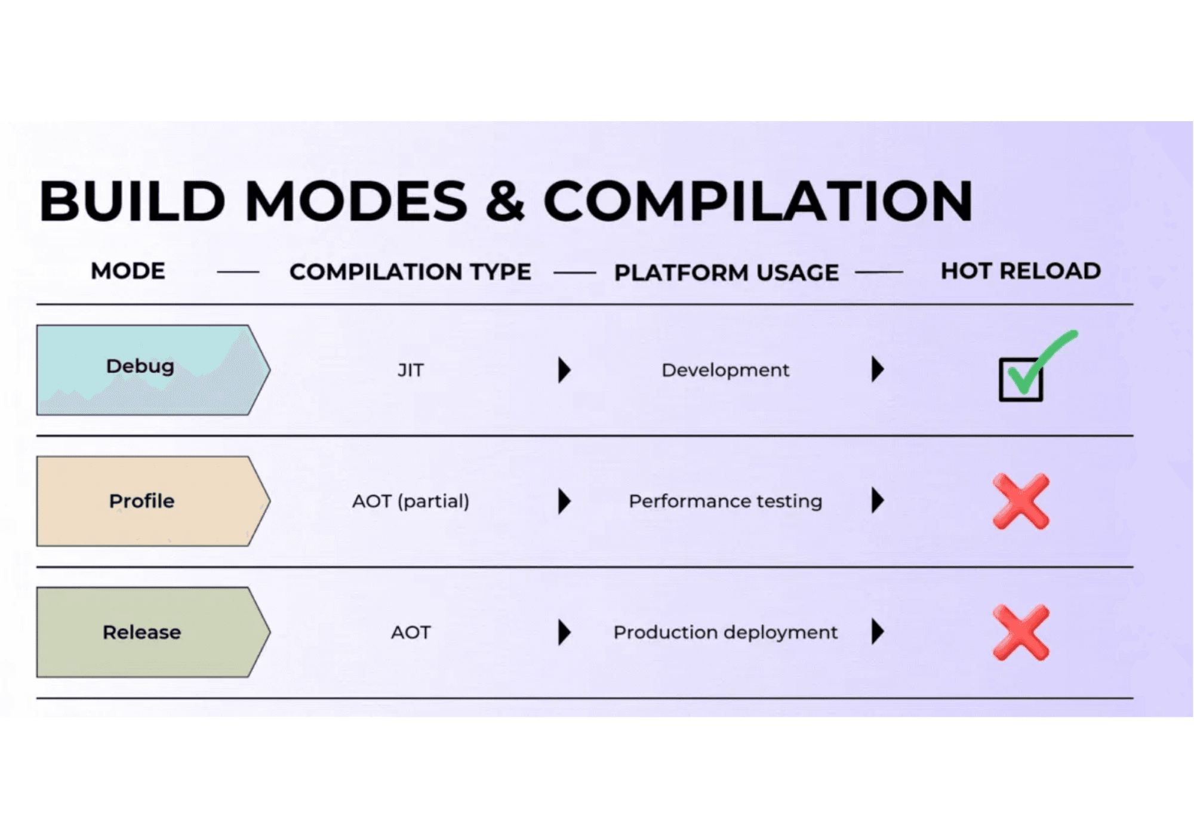
Core Design: The Dual-Compilation Model
JIT (Development)
AOT (Production)
Just-In-Time
Ahead-Of-Time
Used during the development cycle. Code is compiled on the fly within the Dart VM.
Used for production deployment. Compiles code directly to native machine code (ARM/x64).
Hot Reload
Enables sub-second iteration by injecting source code changes into a running application without losing state.
Performance
Eliminates VM warm-up time, ensuring fast startup and consistent runtime performance on user devices.
Visualizing Build Modes: Debug (JIT) vs. Release (AOT)

Slide 5
The Modern
Type System
& Null Safety
Technical Impact
Sound Null Safety
Types are non-nullable by default, eliminating the "Billion Dollar Mistake" (Null Pointer Exceptions) at both compile and runtime.
Soundness
Guaranteed types at runtime if static analysis passes.
Compiler Optimizations
Reified Generics
Soundness allows the compiler to remove defensive runtime checks, leading to smaller binaries and faster execution.
Generic types are preserved and known at runtime.
Type Inference
Provides a balance between type safety and developer productivity, allowing for concise yet robust code.

Slide 6
The Modern Type System & Null Safety
Type
Soundness
Reified
Generics
Sound Null
Safety
Dart 2.0 introduced a sound static type system. If the static analyzer passes, the type is guaranteed at runtime.
Unlike Java's Type Erasure, Dart preserves generic types at runtime. A List<String> is known as such during execution.
Introduced in Dart 2.12, types are non-nullable by default. Nullability must be explicitly declared.
String name = 'Dart';
String? nick; // Nullable
Benefit
Advantage
Enables the AOT compiler to generate highly optimized machine code by removing redundant runtime type checks.
Allows for robust runtime type checking (is List<String>) and specialized VM optimizations for specific types.
Impact
Eliminates "Billion Dollar Mistake" exceptions and allows the compiler to strip null-check overhead.

Slide 7

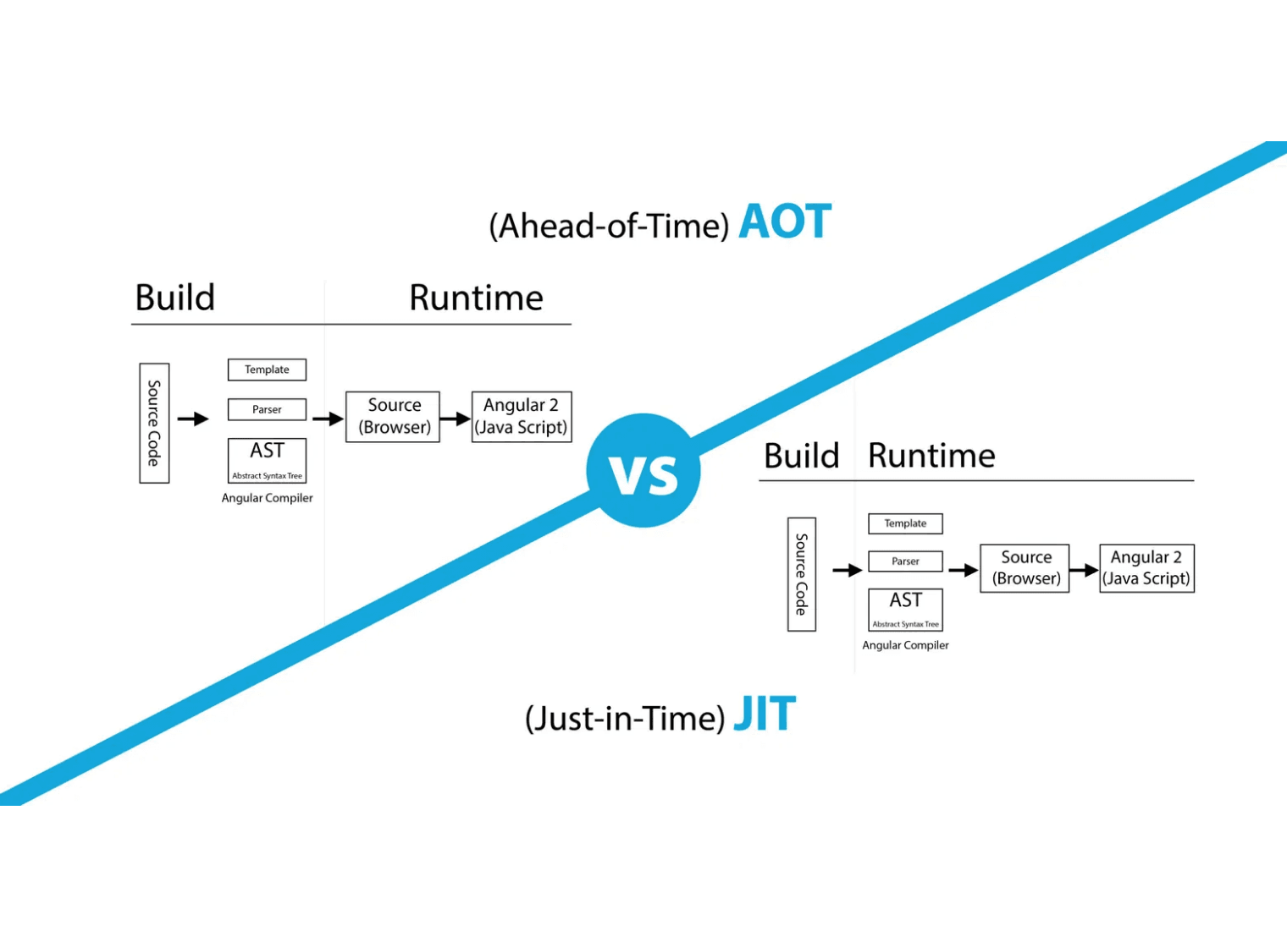
Advanced Architecture:
Concurrency & Startup
Isolates (Shared-Nothing)
Independent workers with their own memory heaps. Communication via message passing (Actor model) eliminates locks and data races.
The Event Loop
Manages Microtask and Event queues. Ensures responsive I/O and UI by processing asynchronous events without blocking.
Visualizing the underlying compilation architecture supporting rapid startup.
Heap Snapshotting
Serializes the initialized object graph into a binary. Achieves < 10ms startup by map-copying snapshots directly to RAM.

Slide 8

Comparative Analysis: Dart vs. Peers
vs.
JavaScript
vs.
Java
vs.
Python
Type System
Generics
Performance
Sound Static vs Dynamic
Reified vs Erasure
AOT Native vs Interpreted
Runtime
Syntax
Safety
Independent VM/AOT vs Browser JIT
Concise/Inferred vs Verbose
Compile-time vs Runtime Discovery
Null Safety
Ecosystem
Sound/Built-in vs Optional/Annotations
Concurrency
Curated (Pub) vs Massive (NPM)
Isolates vs GIL/Threads

Slide 9
Memory Management: Generational GC
Young Space
(Scavenger)
Old Space
(Mark-Compact)
Canonical
Instances
Fast Allocation
Long-Lived Objects
Memory Optimization
Uses bump pointers for near-instant allocation. Optimized for short-lived objects like UI widgets.
Handles objects that survive multiple scavenger cycles. Uses mark-sweep and mark-compact strategies.
const constructors allow identical objects to share a single memory location.
Efficient Collection
Fragmentation Control
GC Pressure Reduction
Only survives objects are copied, making it extremely fast for typical client-side workloads.
Compaction ensures memory remains contiguous, preventing fragmentation in long-running applications.
Dramatically reduces the number of objects the GC needs to track in high-frequency rendering scenarios.
Unified Strategy: Dart's GC is specifically tuned for the high-frequency object creation patterns of modern reactive UI frameworks.

Slide 10
Infrastructure & Ecosystem
Pub
Package Manager
Analysis
Server
Dart
DevTools
Centralized Repository
SDK-Level Intelligence
Performance Suite
pub.dev hosts 55,000+ packages. Uses semantic versioning via pubspec.yaml.
Language logic lives in the SDK, not the IDE plugin. Uses LSP for communication.
Browser-based tools connecting via the VM Service Protocol.
Pub Points
Core Features
Automated scoring system for code quality, documentation, and platform support.
Consistency
CPU Profiler, Memory View (Heap Snapshots), and the Flutter Widget Inspector.
Identical refactoring and error highlighting across VS Code, IntelliJ, and Android Studio.
Unified Toolchain: Dart provides a "complete" experience where the compiler, package manager, and analyzer are tightly integrated.

Slide 11
Case Study:
Recursive
File Searcher
(Grep Clone)
Architecture: Streaming Pipeline
Asynchronous Recursion
Utilizes dir.list() returning a Stream<FileSystemEntity>. Non-blocking traversal ensures the event loop remains responsive during heavy I/O.
Objective
Evaluate Dart for high-performance CLI tasks typically reserved for C++ or Rust.
Memory Safety
Processes multi-gigabyte files in 64KB chunks. Discards strings immediately after regex matching to maintain a constant footprint.
Constraint
Zero external dependencies; rely solely on the standard library.
30-50MB RAM
Constant Memory Footprint

Slide 12
Implementation:
What Helped
Us
Technical Impact
Sound Type System
Caught nullable file handling and type mismatches during development, significantly reducing runtime debugging cycles.
Async Primitives
async/await and Stream made non-blocking I/O trivial.
RegExp Support
Standard Library
Powerful, built-in regular expression engine with easy case-sensitivity control, enabling high-performance pattern matching.
dart:io and dart:convert provided 100% of required functionality.
Zero Dependencies
The "batteries-included" nature of the SDK allowed for a self-contained binary without external package fatigue.

Slide 13


Implementation:
Challenges
& Lessons
Technical Lessons
Robust File Reading
Utilizing allowMalformed: true in Utf8Decoder was critical to prevent crashes on mixed-content directories.
Encoding Hurdles
Handling non-UTF8 bytes in "mostly text" files.
Performance Tuning
Binary Detection
RegExp instantiation must occur outside loops to avoid massive overhead. Skipping minified files via MAX_LINE_LENGTH ensured high throughput.
Avoiding terminal flooding with "garbage" output.
Graceful Exit
Handling FileSystemException for closed output pipes (e.g., grep | head) is essential for a professional CLI experience.

Slide 14
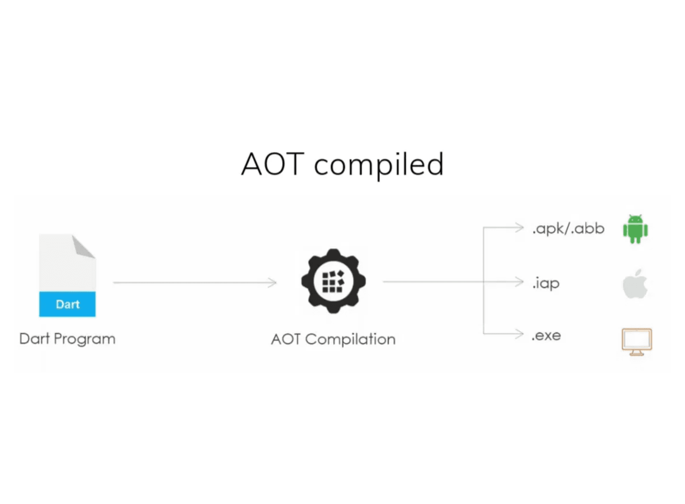
Implementation Highlights
& Optimization
Binary Detection
Heuristic check (first 8KB) for null bytes to avoid terminal "garbage" output. Ensures robust handling of mixed-content directories.
Regex Pre-compilation
Massive speedup by instantiating RegExp outside loops. Leverages Dart's optimized regex engine for high-throughput matching.
Visualizing the AOT compilation process to native binaries.
AOT Performance
Native binary execution with < 10ms startup. Eliminates VM warm-up overhead, making Dart viable for high-performance CLI tools.

Slide 15
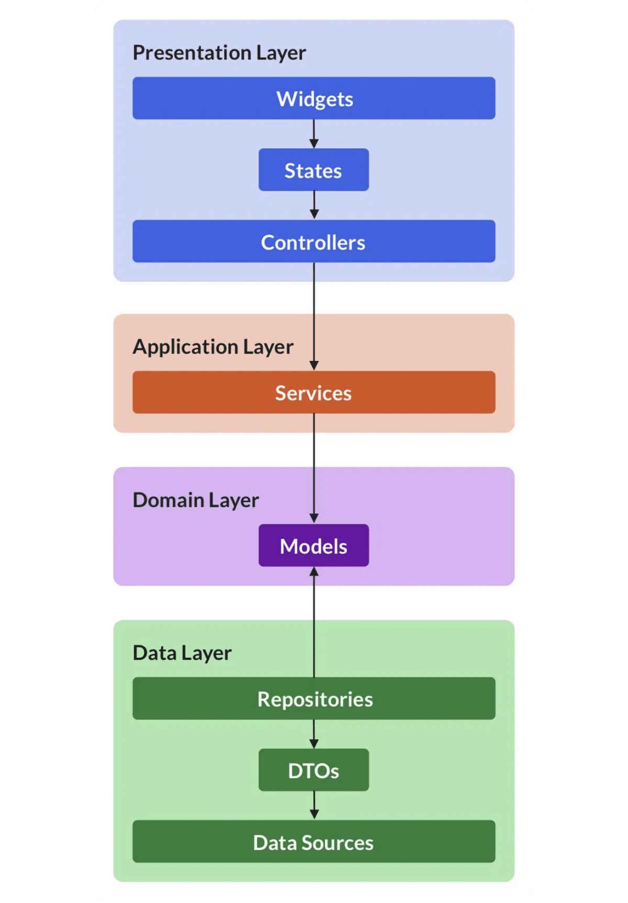
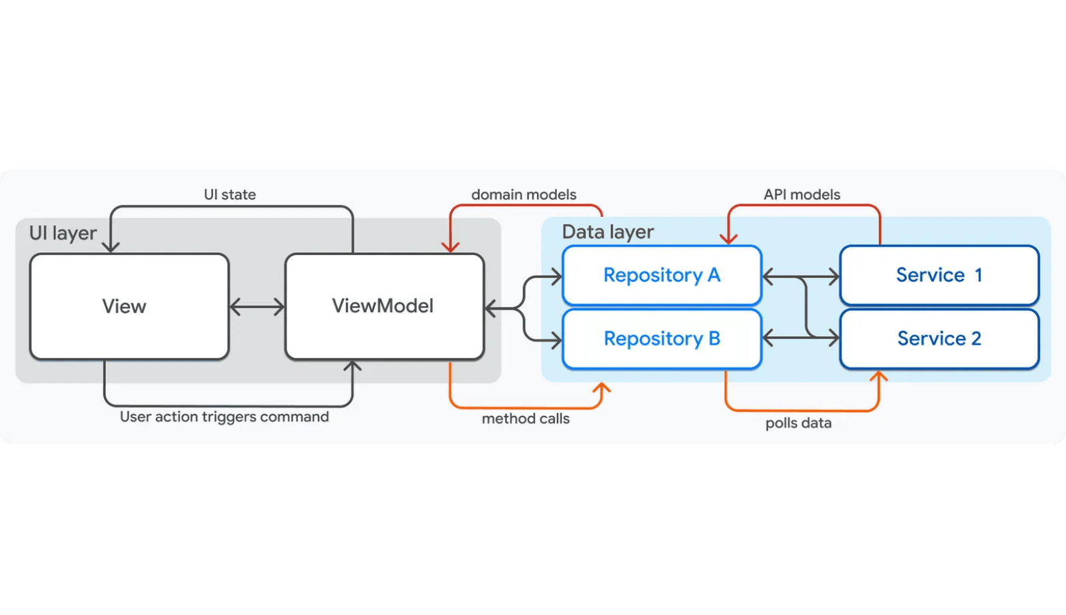
Industry Adoption & Use Cases
Google
Google Ads, Play Console, and Nest Hub setup. Mission-critical internal and external tools.
BMW Group
Unified companion app across iOS and Android, ensuring 100% brand consistency and feature parity.
Data Flow & Repositories
Alibaba
Xianyu (Idle Fish) app serving 50M+ users. High-performance rendering for e-commerce.
Layered Architecture

Slide 16


Academic Assessment
Strengths
Weaknesses
Developer Velocity
Ecosystem Scale
Sub-second Hot Reload cycles and a unified toolchain significantly reduce time-to-market.
While growing, the library selection remains smaller than the massive JavaScript/NPM ecosystem.
Soundness & Safety
Rendering Overhead
Mandatory null safety and a sound type system eliminate entire classes of runtime errors.
Flutter's custom engine (Skia/Impeller) bypasses native UI, increasing binary size and initial load.
Cohesive Ecosystem
Backend Adoption
A robust standard library and centralized package management (pub.dev) minimize dependency fatigue.
Limited market share in server-side development compared to established giants like Go or Node.js.

Slide 17
Conclusion & Future Outlook
Summary
Future Outlook
Strategic Pivot
WebAssembly (Wasm)
Dart successfully evolved from a controversial web experiment to a foundational pillar of modern cross-platform development.
Native-level performance in the browser via WasmGC, finally bypassing the JavaScript bridge overhead.
Full-Stack Unification
Identity Defined
Eliminating "cognitive switching" by utilizing a single language for both frontend and backend delivery pipelines.
No longer just "Google's JS," but a robust, soundly-typed language prioritizing safety, portability, and developer velocity.
Dart is a battle-hardened, industrial-strength language ready for the next generation of high-performance applications.

